Slide 1
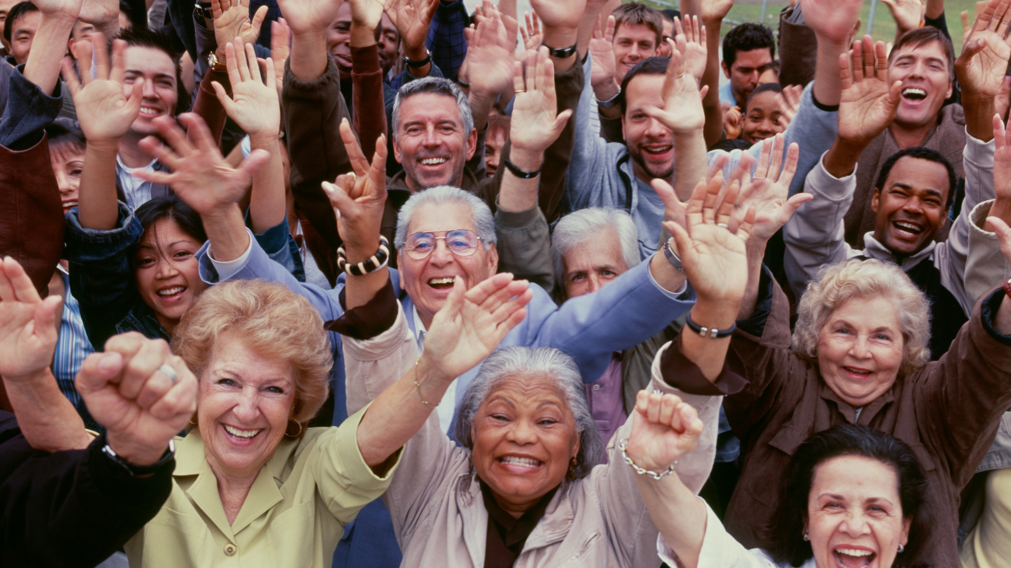

Creating Engaging Training with PowerPoint
Slides for Exercises
Training Conference 2020
Saturday, Feb. 22d from 9 am to 4 pm
Session #P09
Ellen Finkelstein, Inc. ellen@ellenfinkelstein.com www.EllenFinkelstein.com

Slide 2
Legal note:
These photos are only for the exercises for the "Creating Engaging Training with PowerPoint" pre-conference workshop. You may not use them for any other purpose because you don't have a license for them.
I got most of them from stockunlimited.com, where I have an account and got special permission from them to let you use these, but only for the exercises.

Slide 3

The BARE system for choosing the perfect image

Slide 4
We all gain when you reach out to team members

Slide 5
We all gain when you reach out to team members

Slide 6

We all gain when you reach out to team members
Notes:
Blue sweater: https://www.stockunlimited.com/image/hand-touching-a-pregnant-woman-s-stomach_1674463.html

Slide 7

We all gain when you reach out to team members
Notes:
http://images.cdn3.stockunlimited.net/clipart/aerial_1761673.jpg

Slide 8

We all gain when you reach out to team members
Notes:
https://cdn.pixabay.com/photo/2015/05/22/15/58/tough-mudder-779285_960_720.jpg
80+ image sites download

Slide 9

3 ways to use images

Slide 10

The Personal Story
A story from your life or someone else’s life
Many stories involve overcoming difficulties
Stories should build trust
Notes:
https://pixabay.com/photos/woman-model-female-young-portrait-2542252/

Slide 11
Context draws in your audience and starts the connection
Start with a hook, something surprising or unusual
Set the place or situation, including sights, smells, etc.

Slide 12

Always know…
The message you want to convey
The needs and wants of your audience

Slide 13
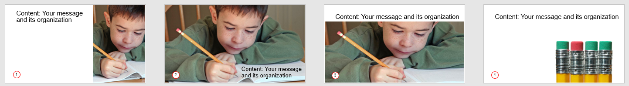
4 layouts that always look good

Slide 14

Content: Your message and its organization

Slide 15

Content: Your message and its organization
Notes:
This slide uses the Title and Lower-Right Photo layout. You can adjust the size of the picture placeholder to suit the photo. If the photo’s background doesn’t match that of the slide, remove the photo’s background, so there’s no “box” around the photo.

Slide 16
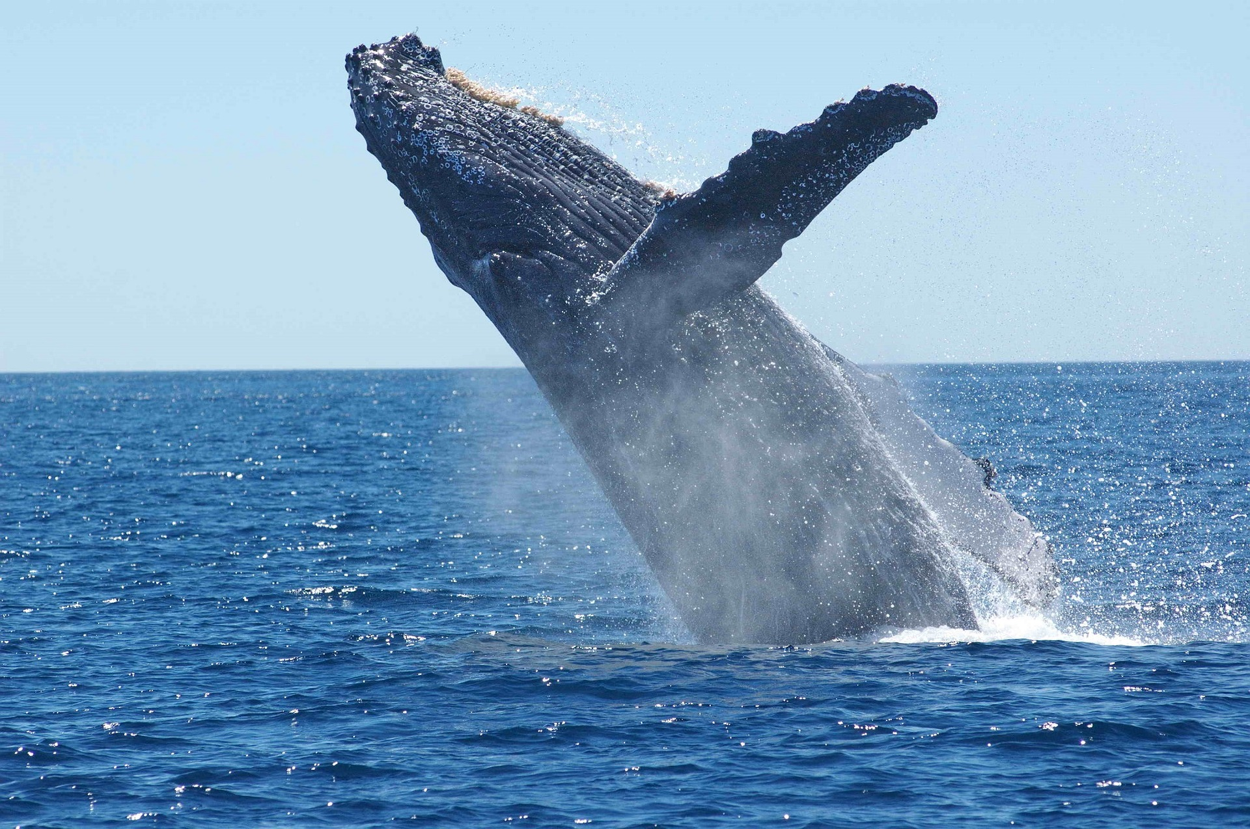
Advanced techniques

Slide 17
Notes:
https://pixabay.com/photos/humpback-whale-breaching-jumping-1945416/

Slide 18

Notes:
https://pixabay.com/photos/humpback-whale-breaching-jumping-1945416/
https://www.ellenfinkelstein.com/pptblog/6-steps-to-create-cool-stickout-photos-in-powerpoint/

Slide 19




Engage people with inclusiveness and protect their privacy

Slide 20

Engaging through interactivity

Slide 21

Create a simple quiz
Next Slide
Notes:
https://www.stockunlimited.com/image/australia-queensland-great-barrier-reef_1896539.html

Slide 22




Which of the following contains the largest amount of water on Earth?
Ground water
Lakes and rivers
Oceans, seas and bays
Ice caps, glaciers, & permanent snow
Back to Lesson
Notes:
Oceans

Slide 23

Try again!
Click to go back to the question

Slide 24
Good job!
Click anywhere to go to the next question

Slide 25
What is the largest source of drinking water on the Earth?
Rivers
Ice caps, glaciers, & permanent snow
Ground water
Coca-Cola
Seas and oceans

Slide 26
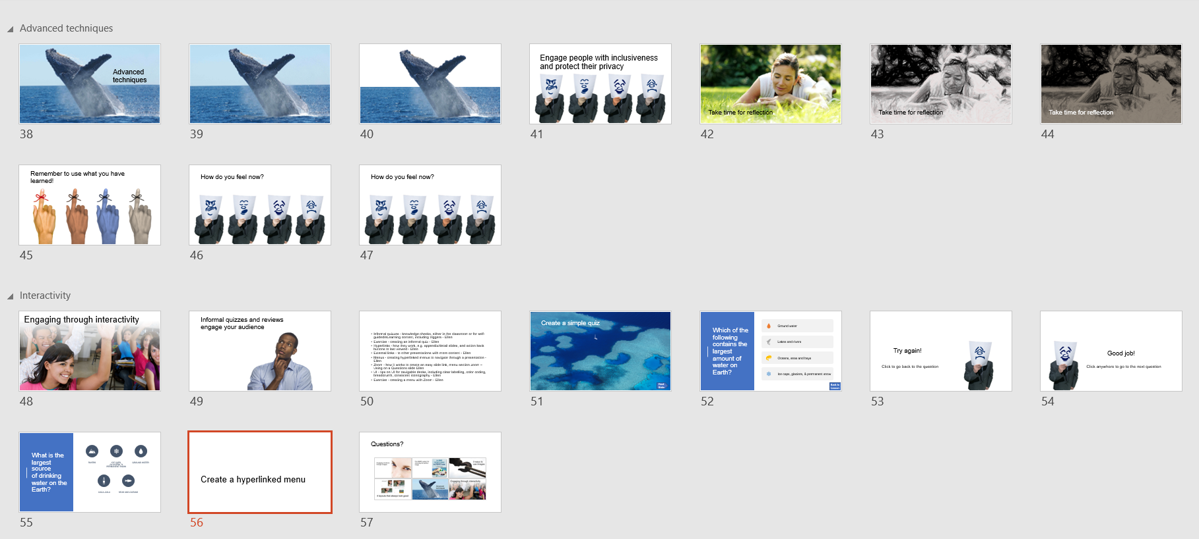

Create a hyperlinked menu

Slide 27


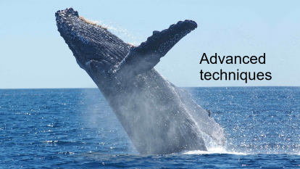
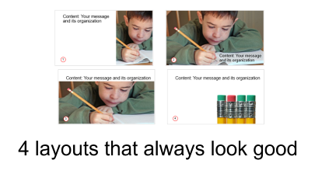


Questions?

Slide 28
Creating Engaging Training with PowerPoint
Slides for Exercises
Training Conference 2020
Saturday, Feb. 22d from 9 am to 4 pm
Session #P09
Ellen Finkelstein is a presentation consultant who specializes in training speakers and presenters to convert Death by PowerPoint to Life by PowerPoint; communicate clearly and powerfully; and design high-impact, persuasive and professional-looking slides.
She has been awarded Microsoft’s PowerPoint MVP (Most Valuable Professional) award for the last 9 years and is one of 18 PowerPoint MVPs in the United States. Her well-known website at www.ellenfinkelstein.com offers many PowerPoint tips and the PowerPoint Tips Newsletter.
Ellen Finkelstein, Inc. ellen@ellenfinkelstein.com www.EllenFinkelstein.com

