Slide 1

CCINW Emerging Trends
2016 and Beyond
Surfaces We Clean
Customer Expectations
Staffing
Laws & Regulation
Marketing
Technology
Wm R. Griffin, President
Cleaning Consultant Services, Inc. www.cleaningconsultants.com,
C-206-849-0179

Slide 2
Surfaces We Clean
More Stone, Tile, LVT, Wood
More Area Rugs
New Expanded Warranties
  Odor and Stain
Pet Friendly
Softer Carpet – Texture retention issues
Less Carpet – Industry Position
New Faux Surfaces – Photos

Slide 3
Customer Expectations
Knowledgeable
Assertive
Sustainable
Younger Generation
Children and Singles (women & ethnic)
High Expectations
  Professionalism
  Certification

Slide 4
Staffing
Finding and Keeping Employees
Expectations
Young Generation
Vocal
Engagement
Pay and Benefits
Partners – Different Models

Slide 5
Laws & Regulation
Higher and More Taxes
Hidden Costs
Barriers to Start Up - No Cushion
Barriers to Business Operation
WA. Not a Business Friendly State
Increasing Power and Oversight
Banking & Seizure Powers

Slide 6
Marketing
New Ways to Reach and Convince
Internet - Website
Social Media
Yelp & Others
Uber, Air B & B
Amazon, Home Depot and ???
Take Care of the Customer
Stay Current with the World

Slide 7
Technology
High Tech Carpet
  Sensor and linked
Build it Pet Friendly
Evolving Cleaning Processes
  Dry vapor and ???
Fact Based Science
  Vacuuming of dry soil
  Focus on Prevention
    Shoes, pets, entry matting, rugs
  Fibers and Construction
  Renters – liability – 80% with pets

Slide 8
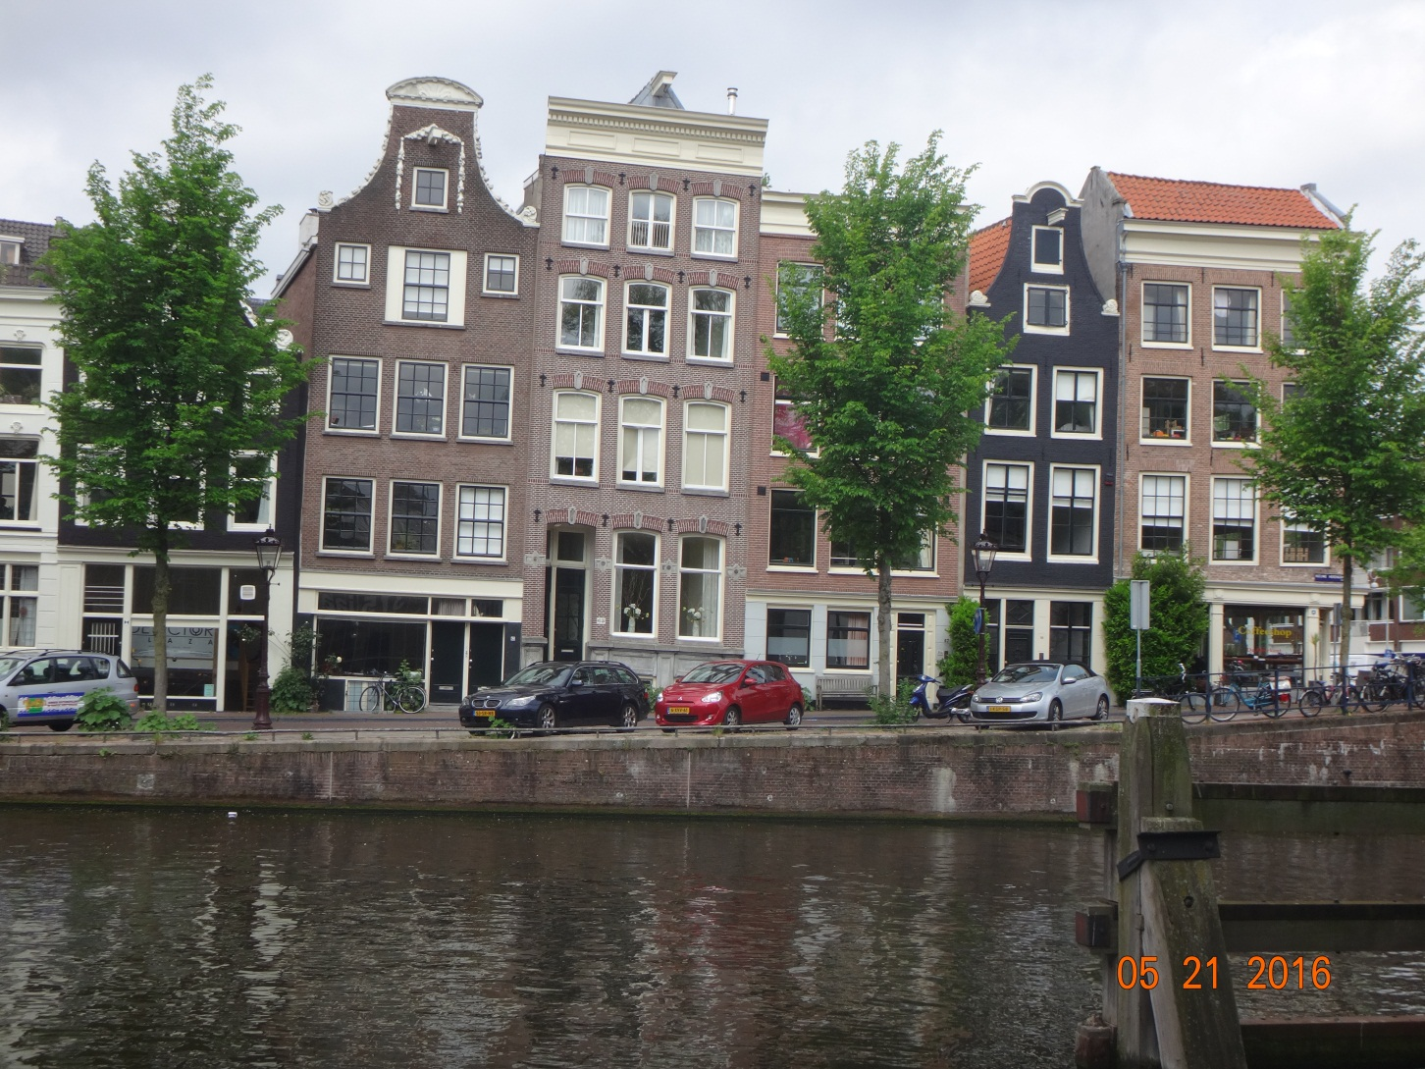
Amsterdam Leaning Buildings

Slide 9

Lucerne, Switzerland

Slide 10
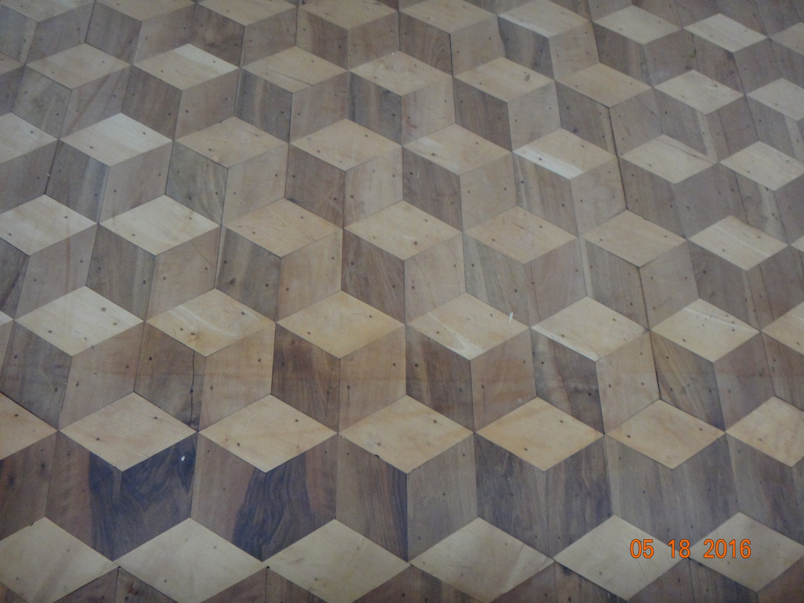
Wood Floor – 3D - Installed in 1740

Slide 11
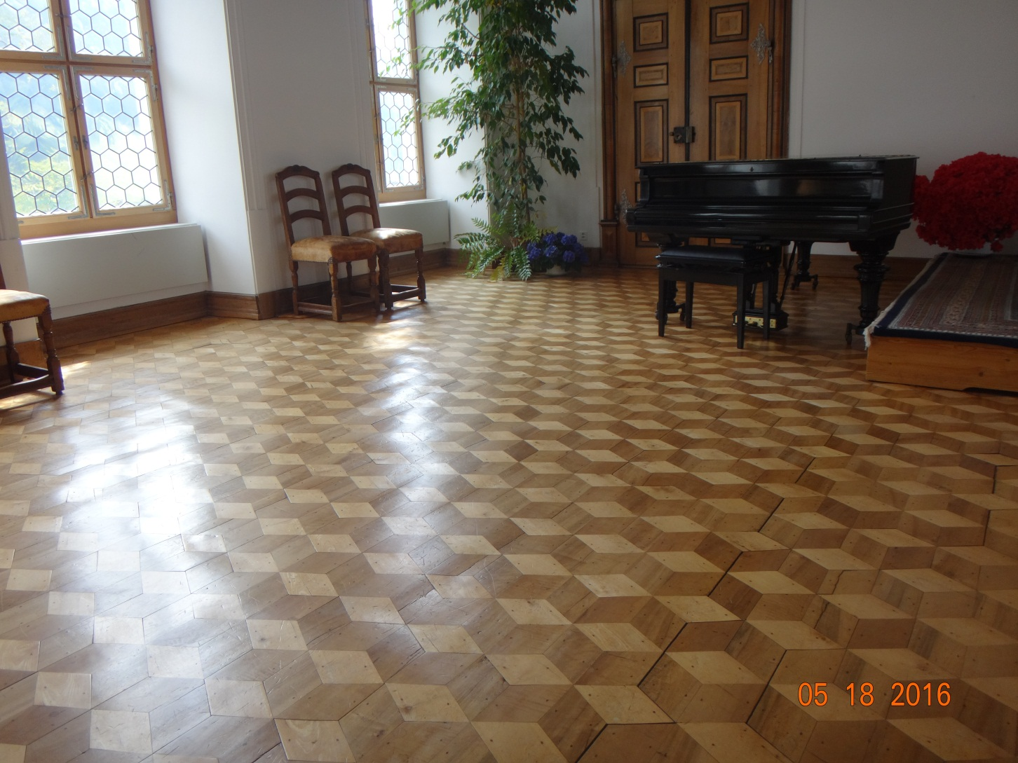
Same Floor Different View

Slide 12
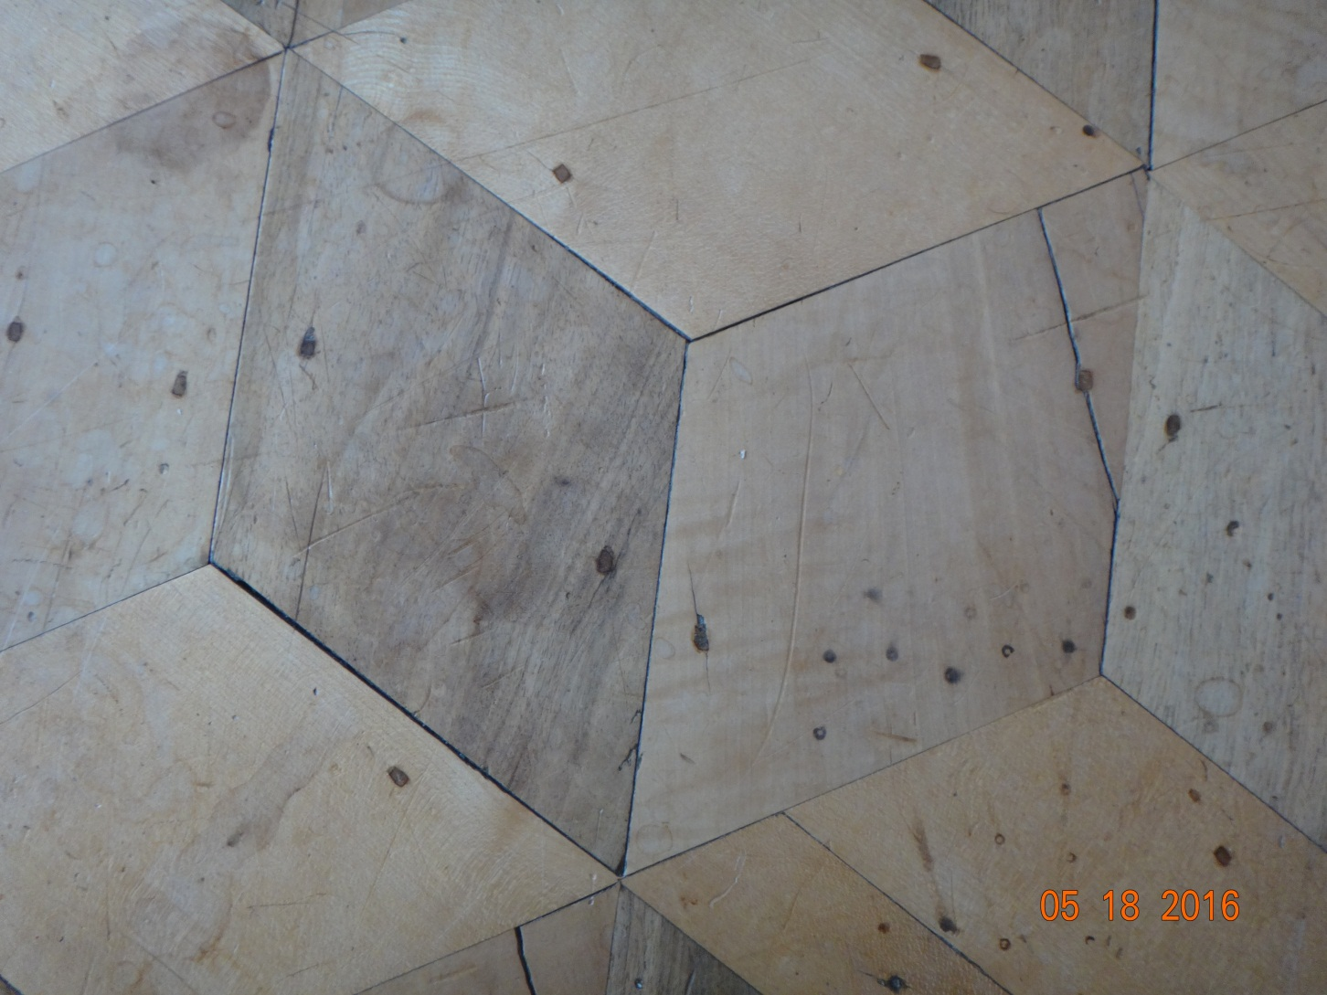
Same Floor No Nails – Wood Pegs

Slide 13
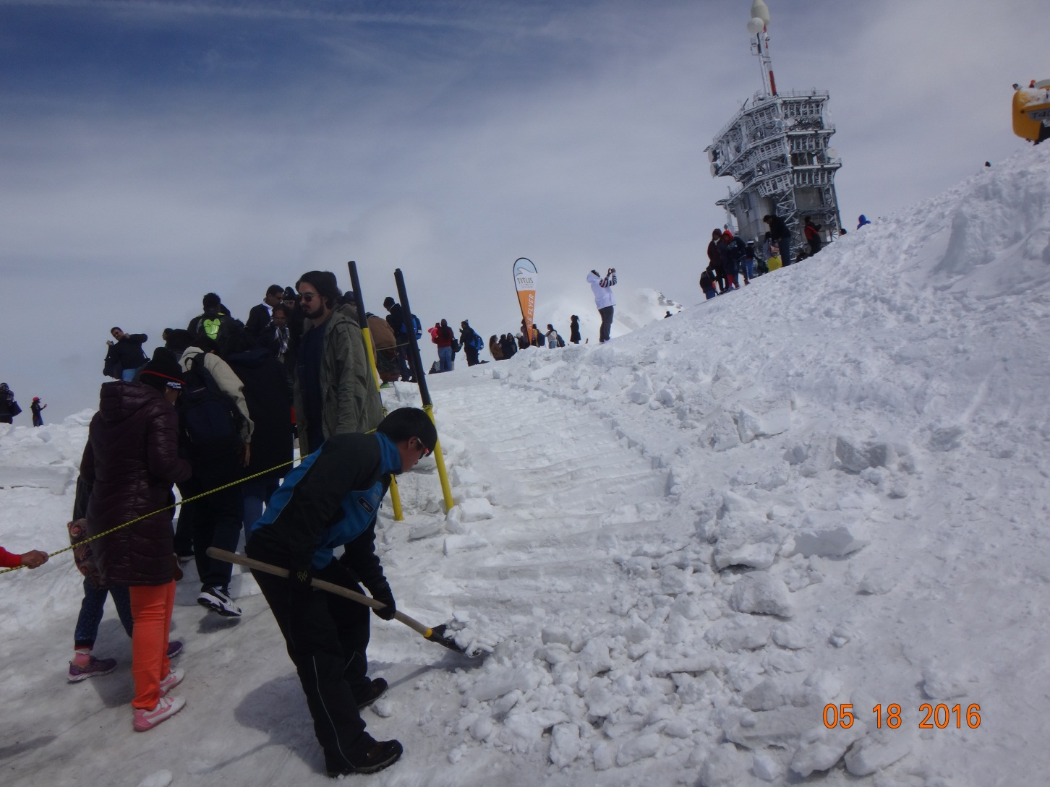
Cleaning at 10,000 Feet

Slide 14
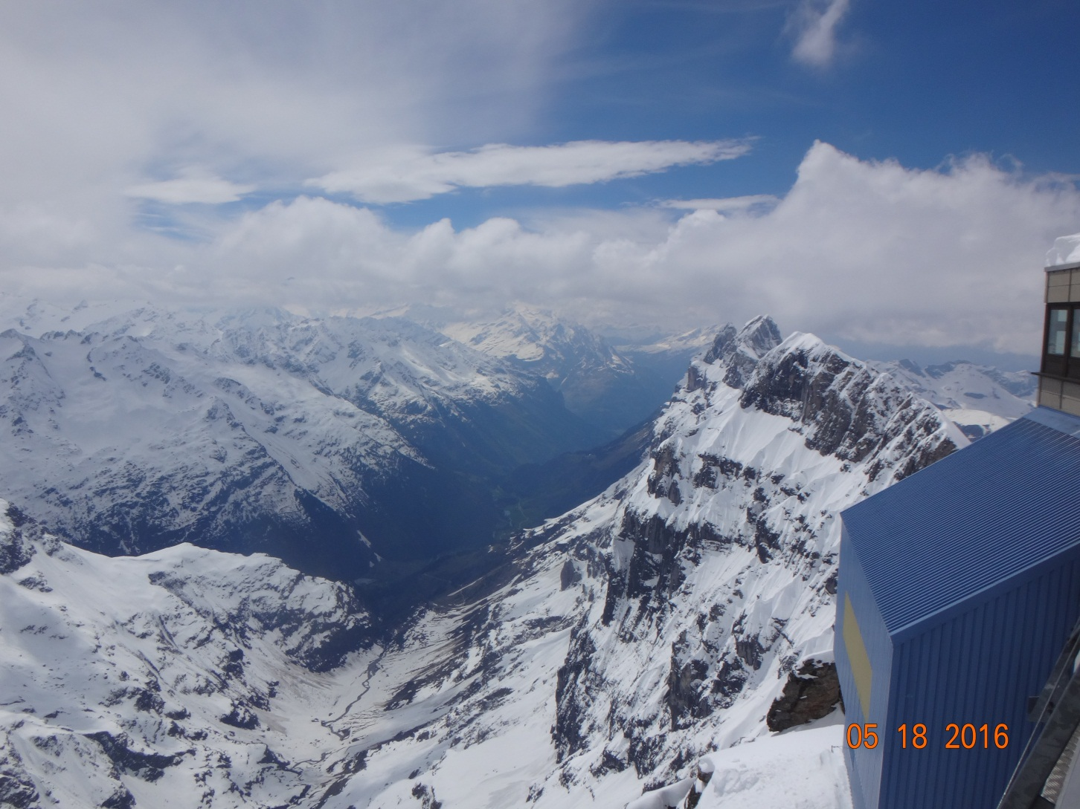
View From 10,000 Feet

Slide 15
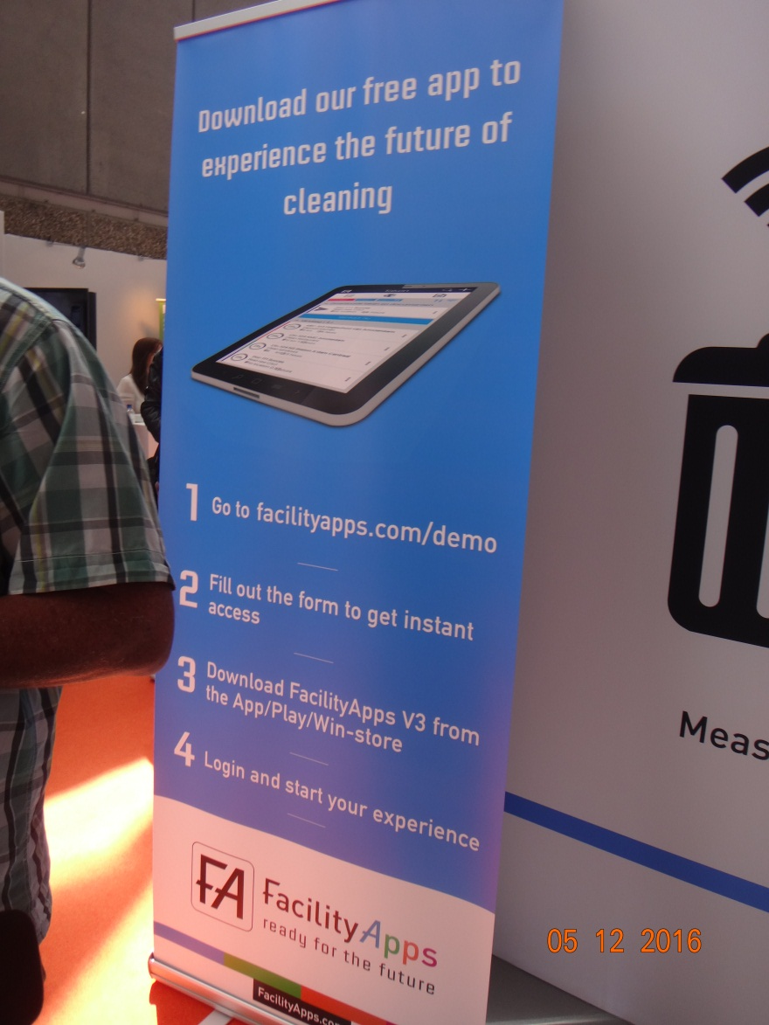
Facility App

Slide 16
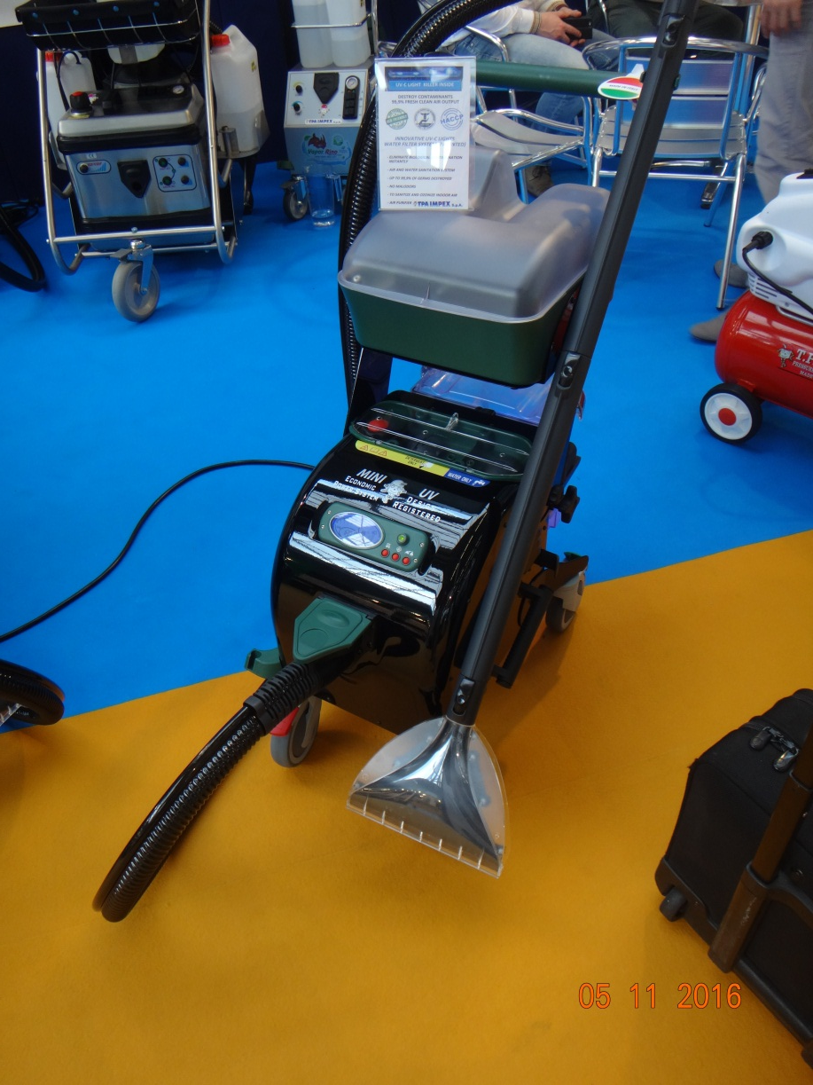
Dry Vapor Carpet Extractor

Slide 17
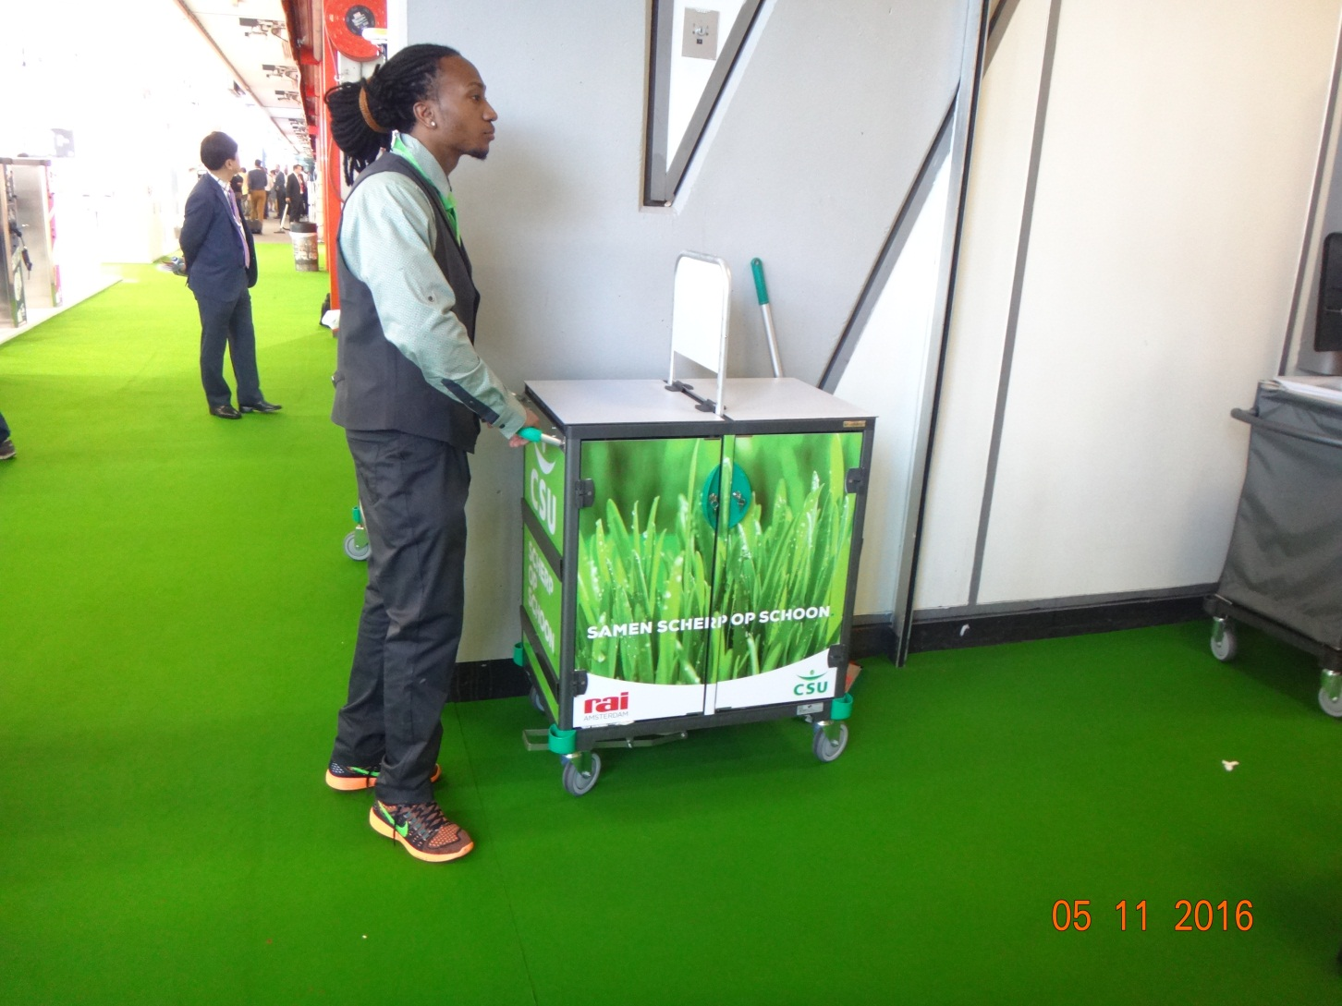
Personalization of Carts & Equipment

Slide 18
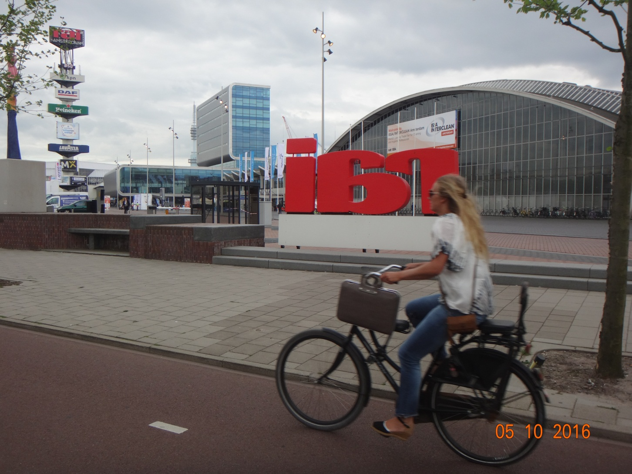
RAI Hall – Amsterdam
Home of ISSA/INTERCLEAN

Slide 19
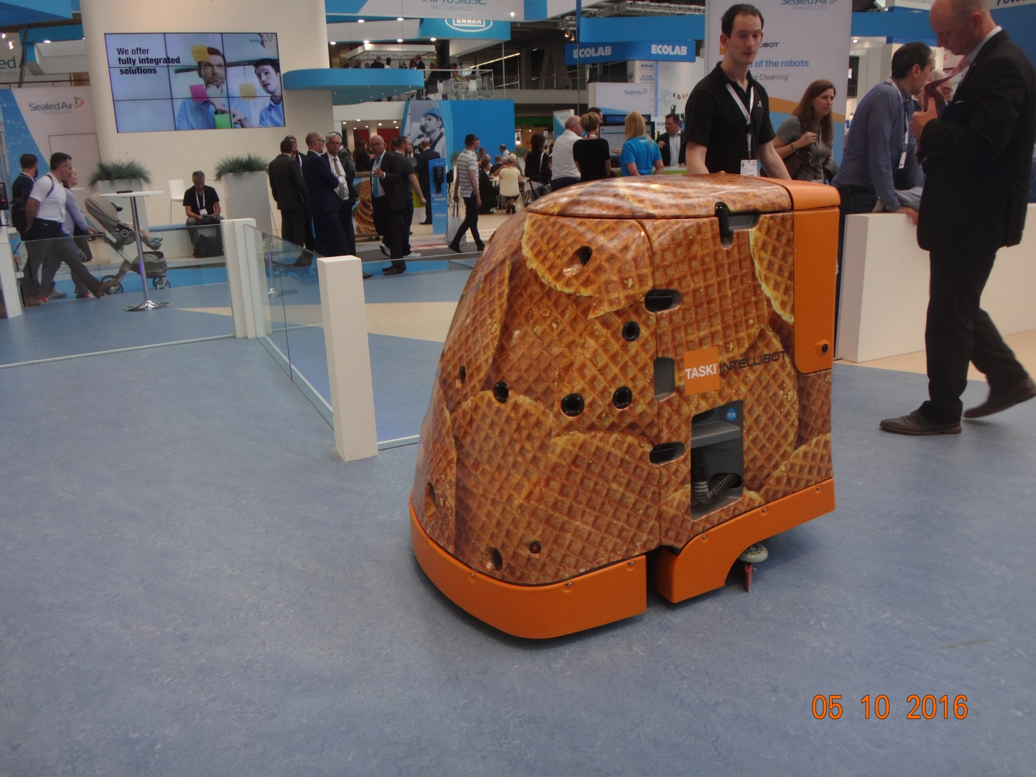
Robotic Scrubber Drier

Slide 20
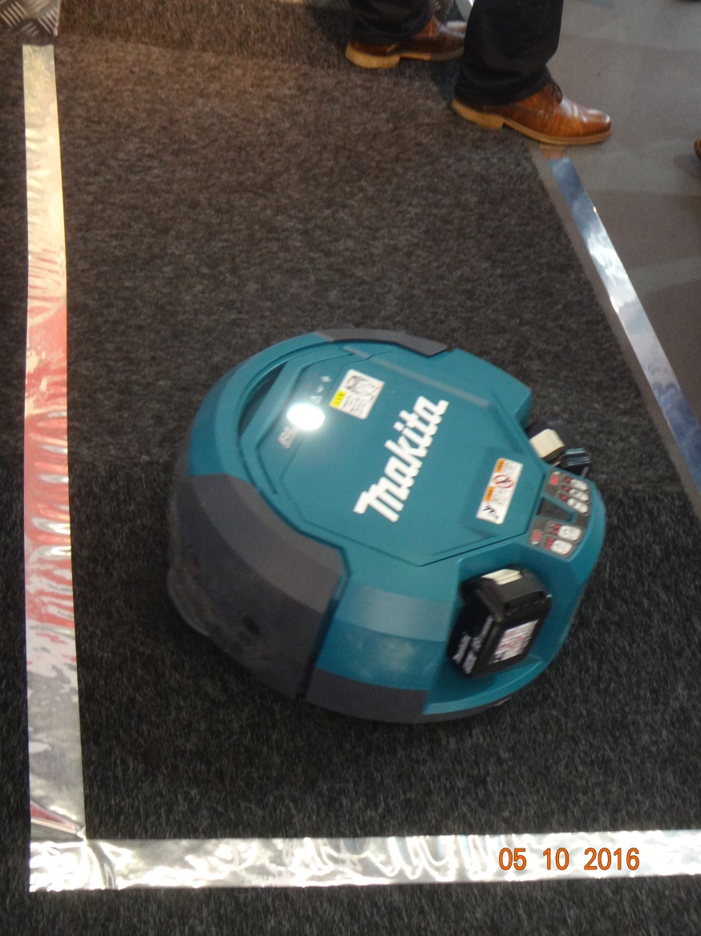
Makita Robot Vac

Slide 21
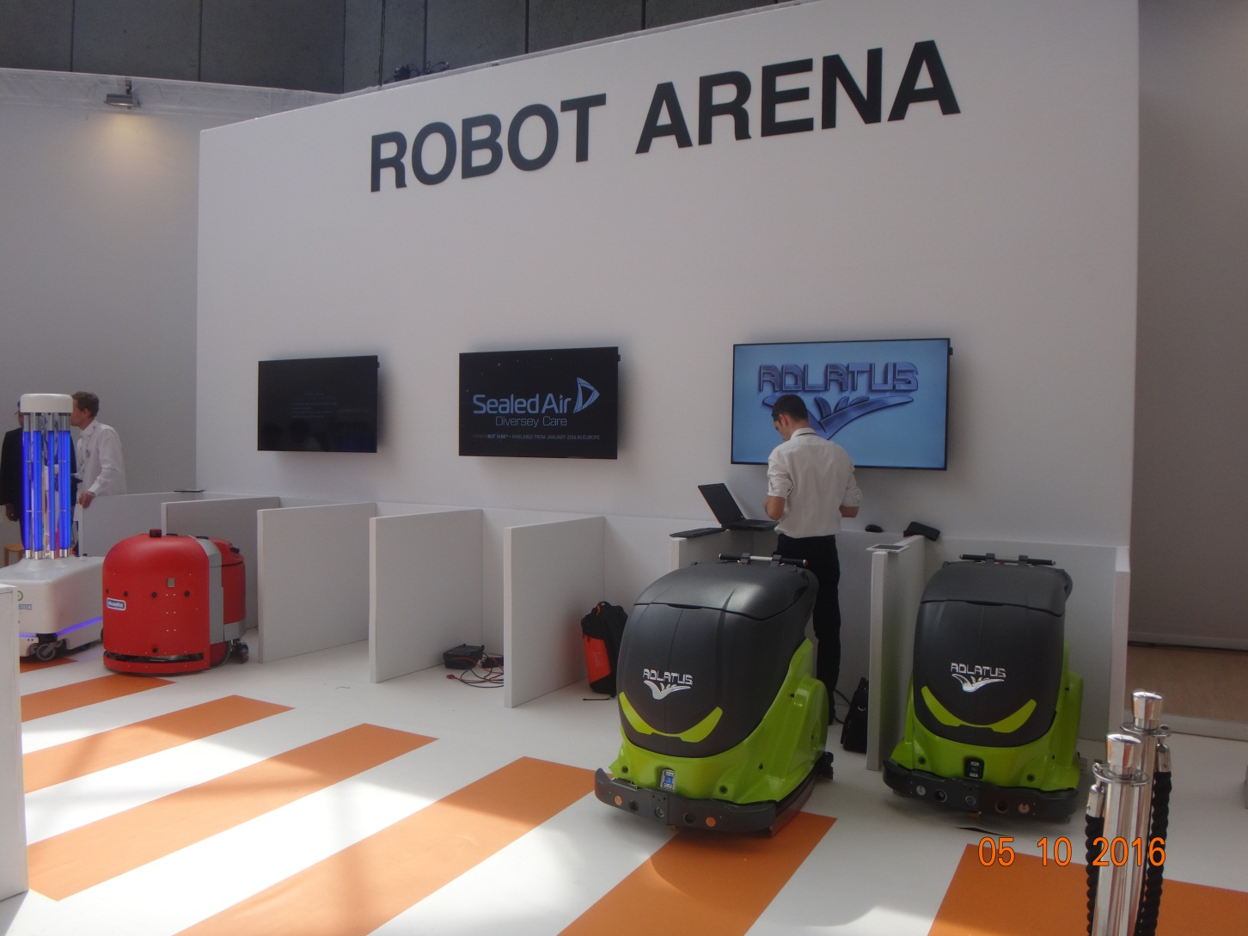
Robot Arena

Slide 22
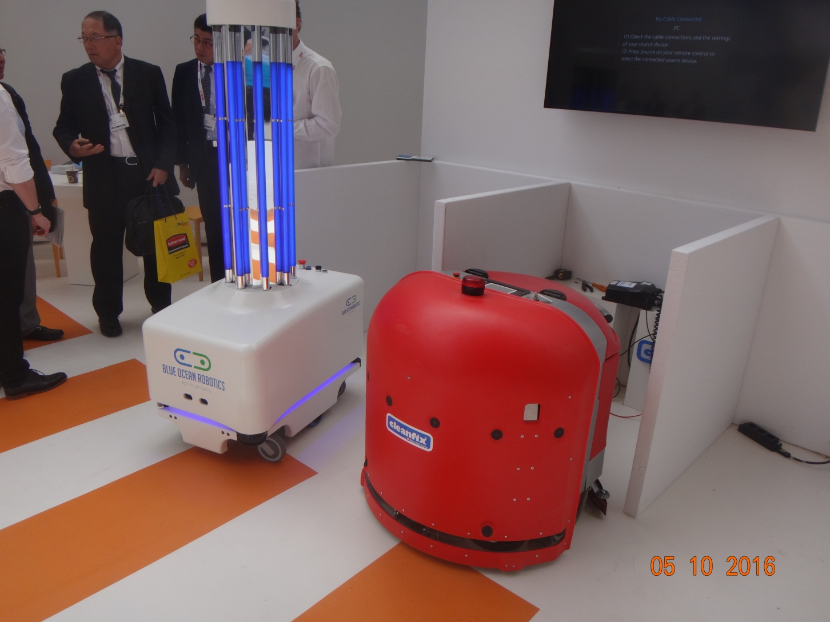
Two Robots

Slide 23
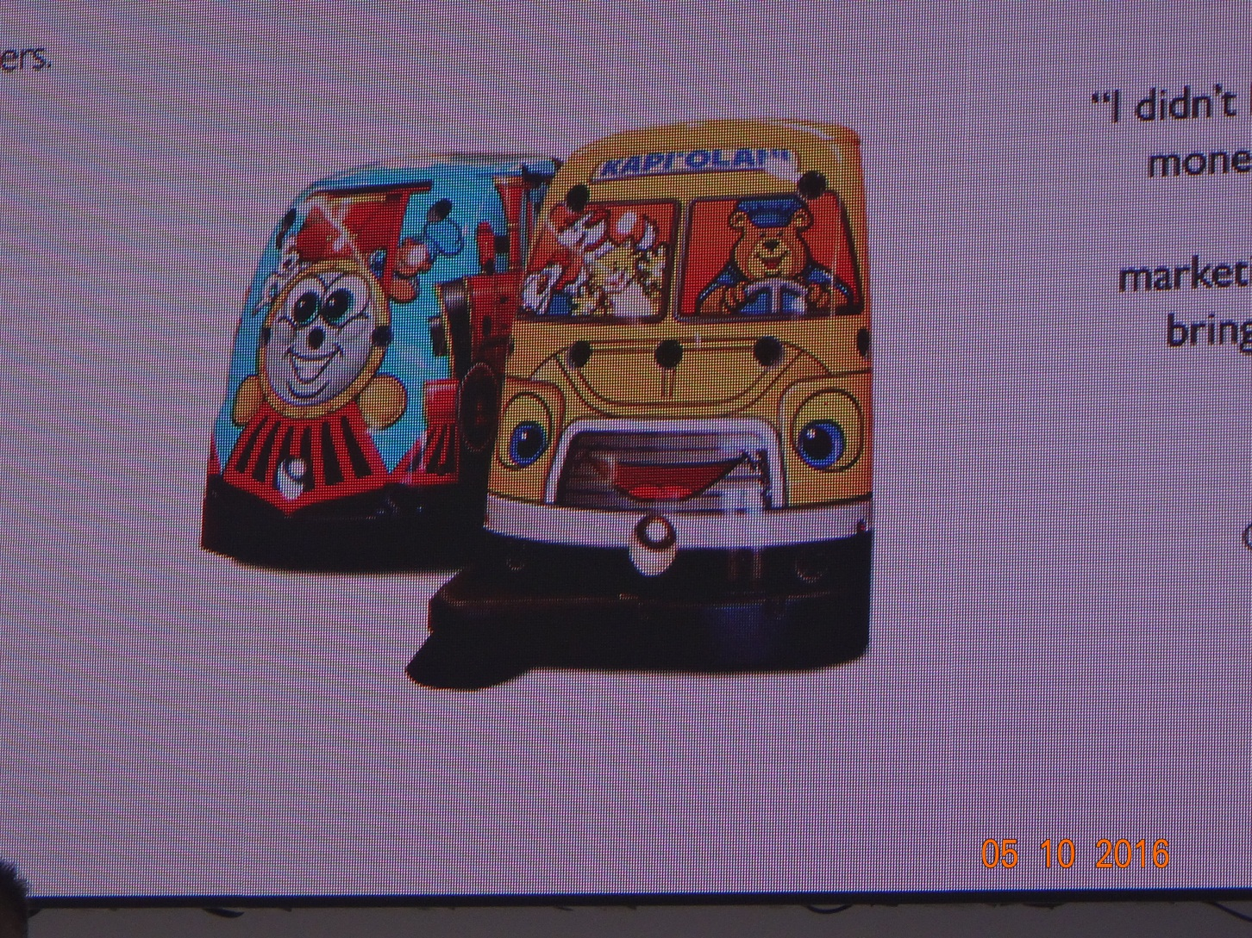
Robots for Education Market

Slide 24
Everything is Changing
  People – Next Gen - Retirement
  Surfaces – Self Cleaning
  Why we Clean - Health
  How we Clean - Processes
  Chemicals – Equipment
  Expectations - Validation

Slide 25
No One Stands Still
Getting Better or Getting Worse
No middle ground.
What it means to you.

Slide 26
Technology
Smart Phones – Software - Apps
Equipment
Digital World – Everything linked -Carpet
Robotics
Engineering and Design
Nano
Green and Sustainable

Slide 27
Opportunities
Never been a better time to be in cleaning or maintenance
Risks are present
Tipping point
  Technology
  Cost
  People

Slide 28
Hard Floor Care
Carpeting
Low Maintenance Surfaces
Faux Surfaces

Slide 29
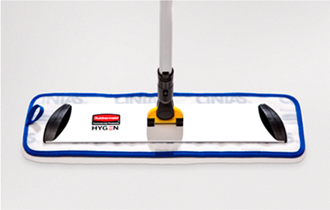
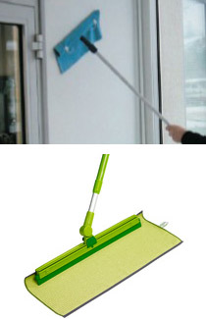
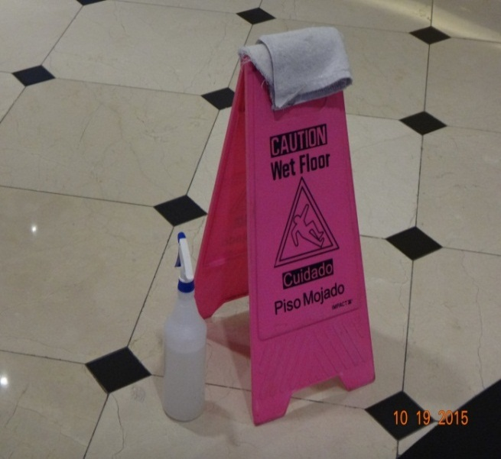
Micro Fibers and Flat Mops
Reflex Mopping System
Rubbermaid
Economy bucketless mopping system
www.rubbermaid.com
www.primcosolutions.com

Slide 30
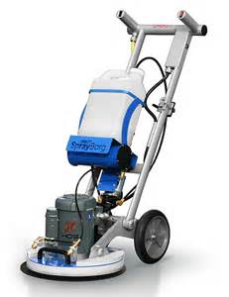
HOS Orbot Orbital Floor Machine
Ease of use
Works on all surfaces
  Carpet
  Wood
  Stone/Concrete
  Terrazzo
  Ceramic Tile
  VCT
www.hos-usa.com

Slide 31
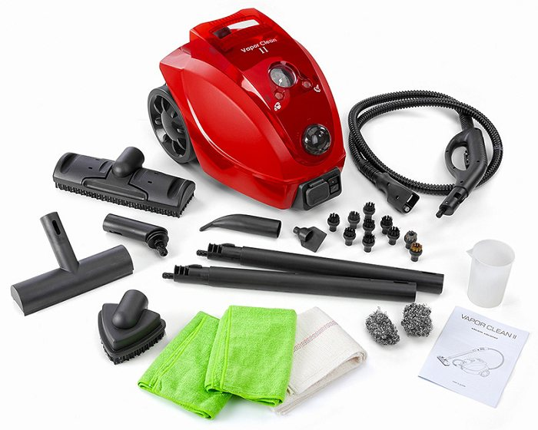
Dry Vapor Steamer - TANCS
www.advap.com

Slide 32
New Trends
Wireless/Digitally Connected
Sensors on Everything
Personality for Robots
Fleet Management
3rd Party Audits & Certification

Slide 33
New Chemicals
Less Chemicals
No Chemicals
Chemical Free Cleaning Network www.cfcn.info

Slide 34
Engineered Water
www.annihilare.com
www.geneontechnologies.com
www.ecolab.com
www.pathosans.com
www.cleancoretech.com
www.hsp.com
www.zbioscience.com (probiotics)

Slide 35
Nano Disinfectant Products
www.microx1.com/microx1_microprotex.html
www.genesisurfacetechnologies.com
www.bactibarrier.com
www.permanonusa.com
www.ecosealsafe.com
www.xytoblast.com

Slide 36
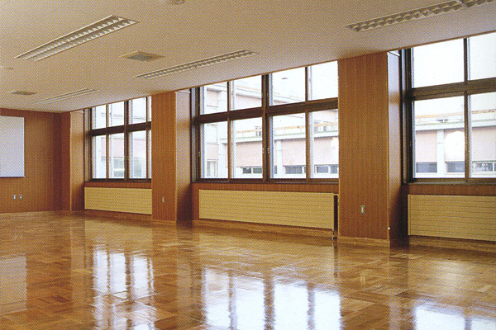
Nano Quartz Coatings
www.inovexcoatings.com

Slide 37
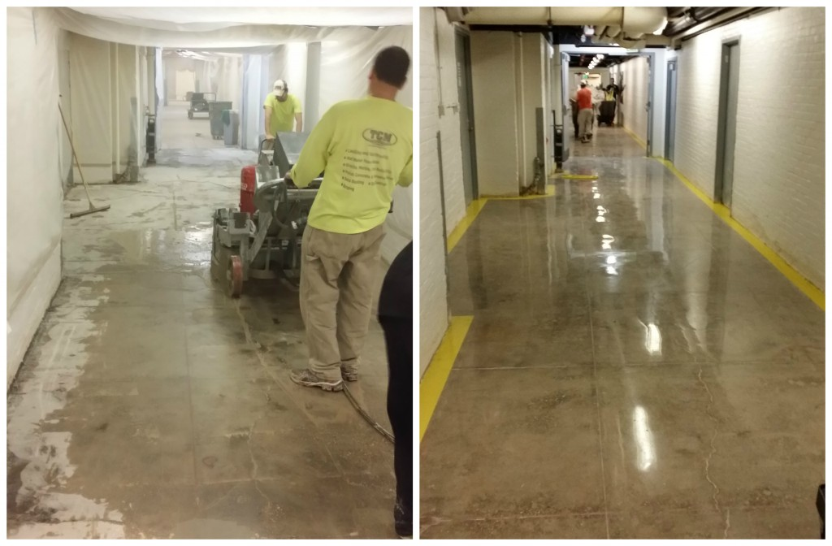
SIMIX Coatings
www.simixusa.com

Slide 38
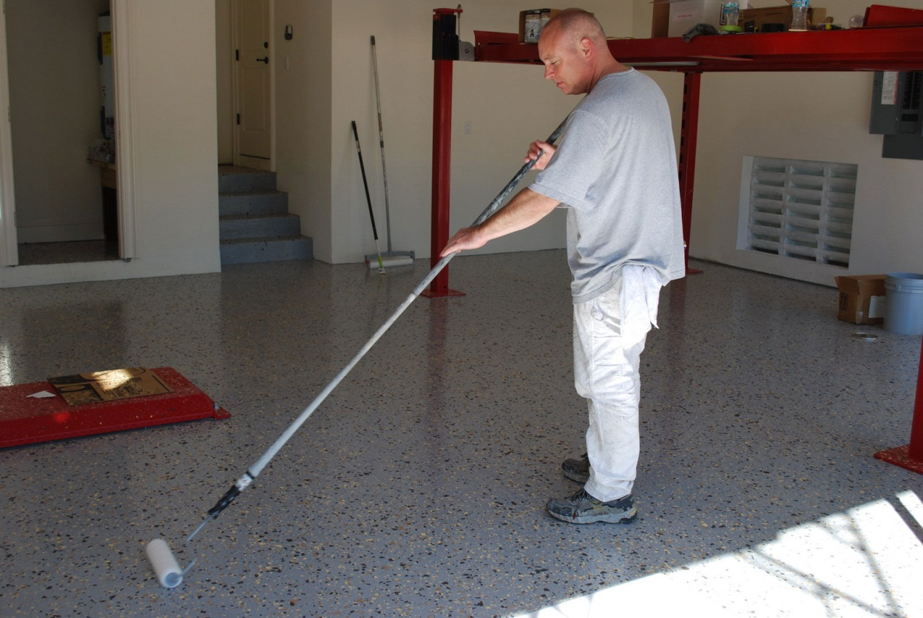
Semi-Permanent Coatings Urethane
www.ultradt.com
P-320-266-0718

Slide 39
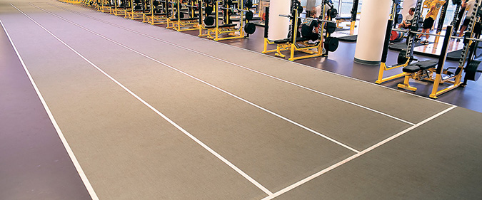
Mondo Flooring
www.mondocontractflooring.com

Slide 40
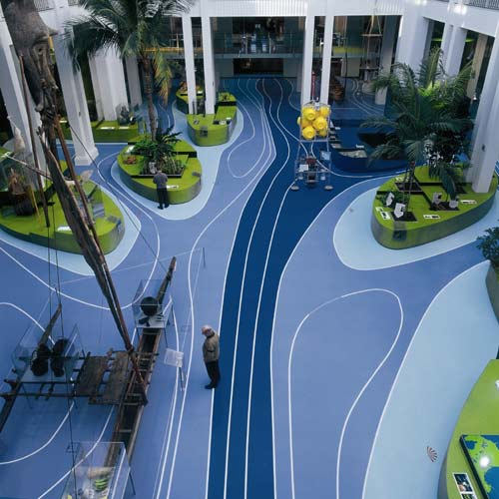
Nora Flooring
www.nora.com

Slide 41


Wood Refinishing & Repair
Tools, stains and training for wood and leather repair and refinishing
Mohawk Finishing Products
    www.mohawk-finishing.com, P- 800-545-0047
Konig Touchup
    www.konigtouchup.com
www.cal-floor.com (repair kits for all floors)
National Wood Flooring Association
    www.nwfa.org
Maple Flooring Manufacturers Association
    www.maplefloor.org

Slide 42
You must be aware of and prepare for changes taking place today and in the future.

Slide 43
Impactors on Cleaning Results and Carpet Life
Specification and Installation
Spotting (daily)
Vacuuming (dry soil removal)
Cleaning (interim & deep cleaning)
Repair (seams, sprouts, edges)
Replacement (beyond cleaning)
Disposal/Recycle (green)

Slide 44
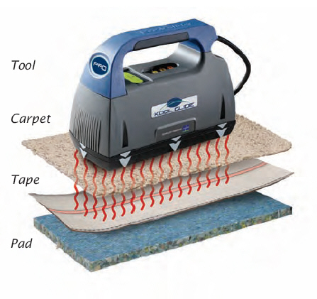
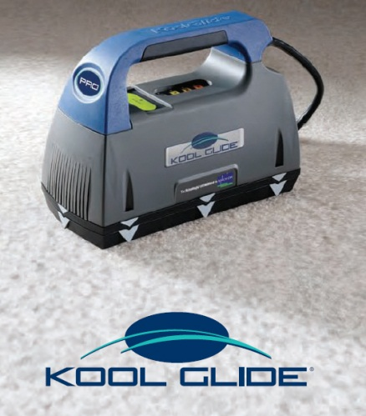
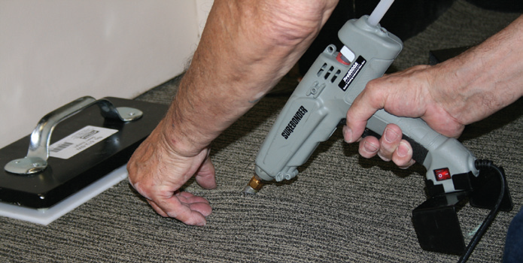
New Carpet Installation Technology
Koolglide “Radio Wave” Seaming Iron
Gundlach Hot Glue 2 Seaming Gun/System
Spot Dye Kits
Coatings and Treatments (Nano/Inovex)

Slide 45
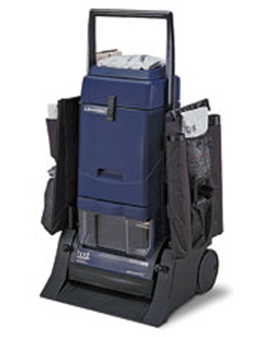
Carpet Vacuum/Pile Lifter
“Host” Liberator
4 Stage Vac
Cylindrical Counter Rotating Brushes
Lifts Pile
Low Moisture
Powder Or Encapsulate
www.hostdry.com

Slide 46
Amsterdam ISSA Videos
Top Innovations at ISSA/INTERCLEAN 2016
https://www.youtube.com/watch?v=QE5-3bTMnlw
An interview with yours truly, and other show interviews by Vincent Everts.
https://www.youtube.com/watch?v=Gmi0sMcPa1Q&feature=youtu.be
Don’t miss the ISSA INTERCLEAN Show North America, in Chicago, Oct 23 – 26, 2016.

Slide 47
Insights from Amsterdam
Speed of Change and Evolution
Robotics – Evolving – Sealed Air
Linked, Tracked & Monitored
Sensors and Beacons
Digital World is Right Around the Corner
Augmented Reality
Internet of Clean

Slide 48
Free Stuff Links www.cleaningconsultants.com
Emerging Trends PPT
http://www.cleaningconsultants.com/freestuff/Emergingtrendsincleaning0516.pdf
Effective Training PPT
http://www.cleaningconsultants.com/freestuff/EffectiveTraining2016.pdf

Slide 49

Flower

Slide 50

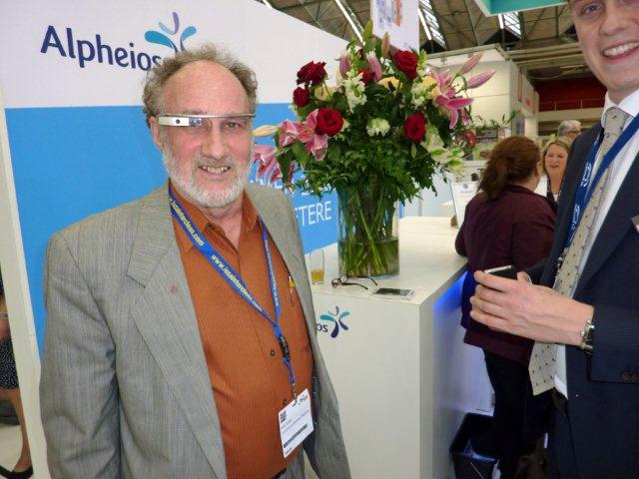



Thank You
Wm R. Griffin, President
Cleaning Consultant Services, Inc.
www.cleaningconsultants.com
C-206-849-0179

